Slide 1
TechDay#6 – Docker & Spring Boot
Abril 2017
Madrid – Barcelona - Jerez
Notes:
Portada Sedes

Slide 2


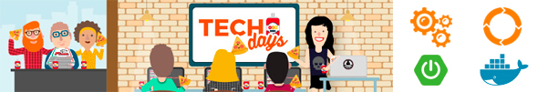
Contenido de la Sesión
Introducción a Spring Boot (30 min.)
Introducción a Docker (30 min.)
Desarrollo de un servicio con Spring Boot.
Encapsulación y ejecución del servicio desarrollado en un contenedor Docker.

Slide 3
TODO Spring Boot

Slide 4
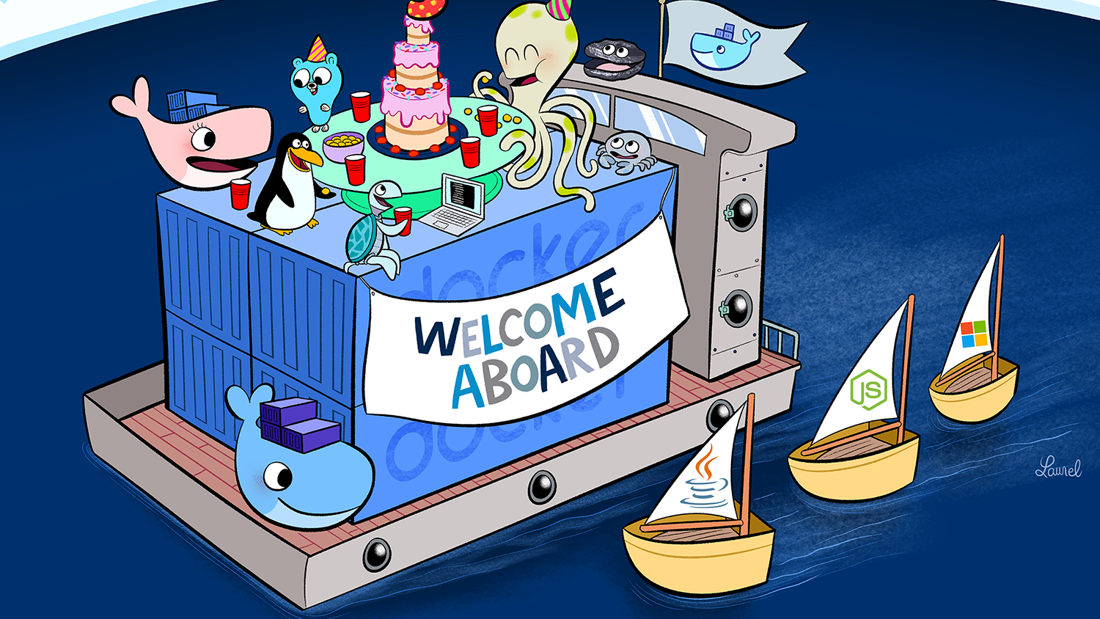

Slide 5
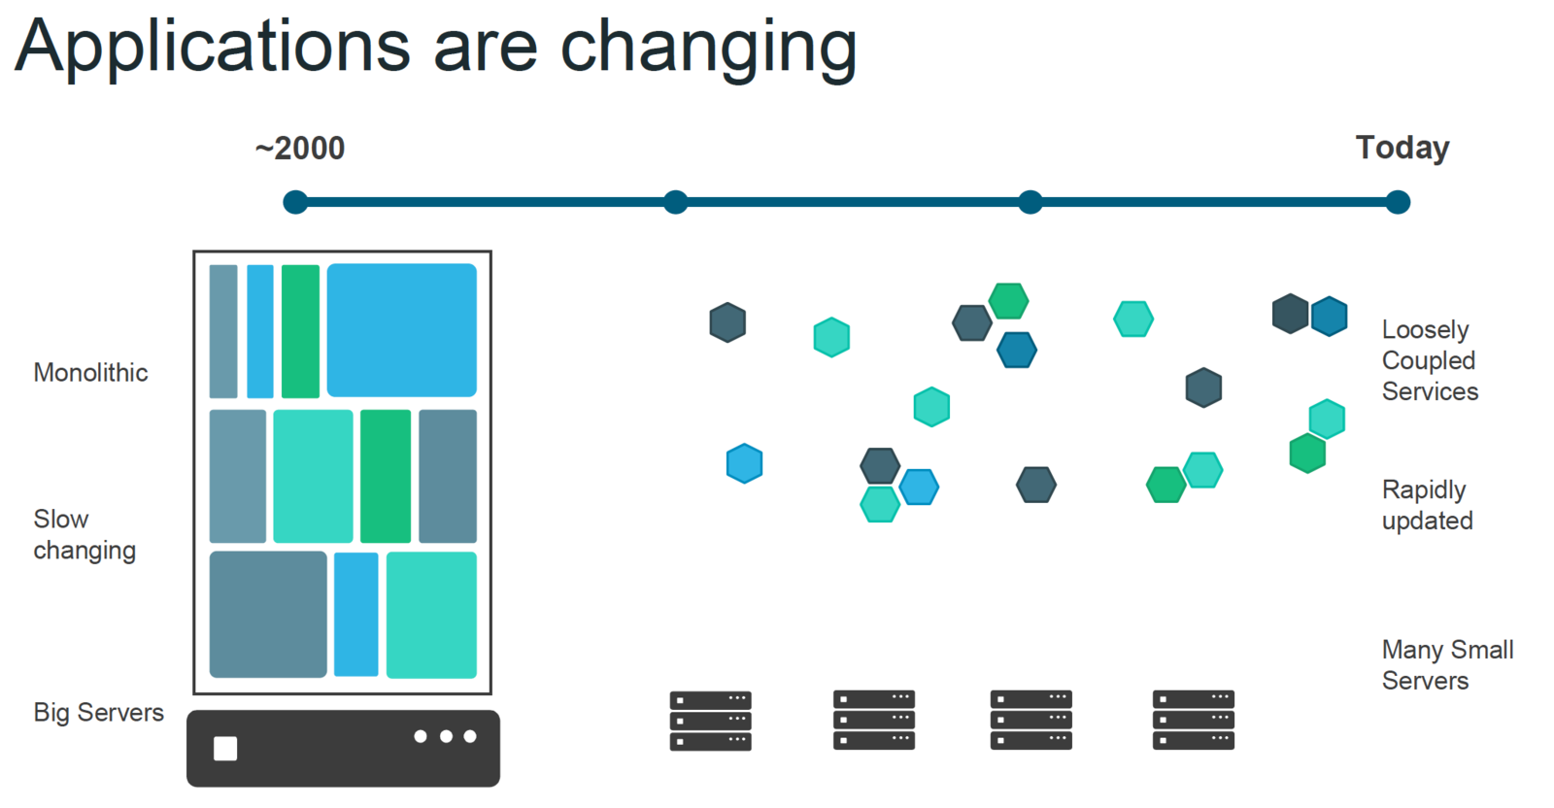

Slide 6
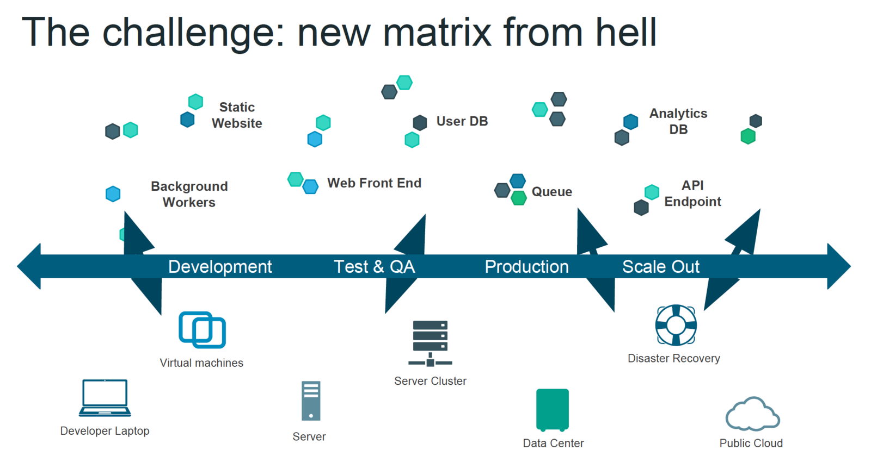

Slide 7
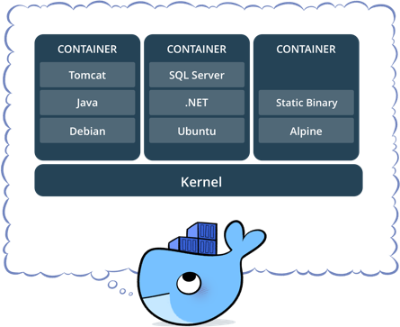
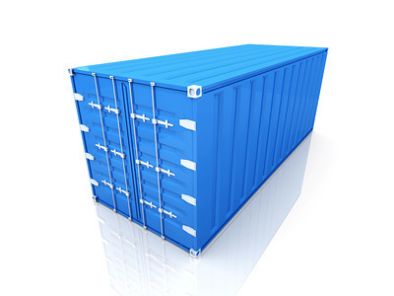
Linux Containers
Docker is based on LXC (Linux Containers) which allows
it to isolate containers from each other.
LXC use mainly two Linux Kernel features to achieve it :
Namespaces (Isolation of resources)
Cgroups (Isolation of resource usage, as CPU/RAM)

Slide 8
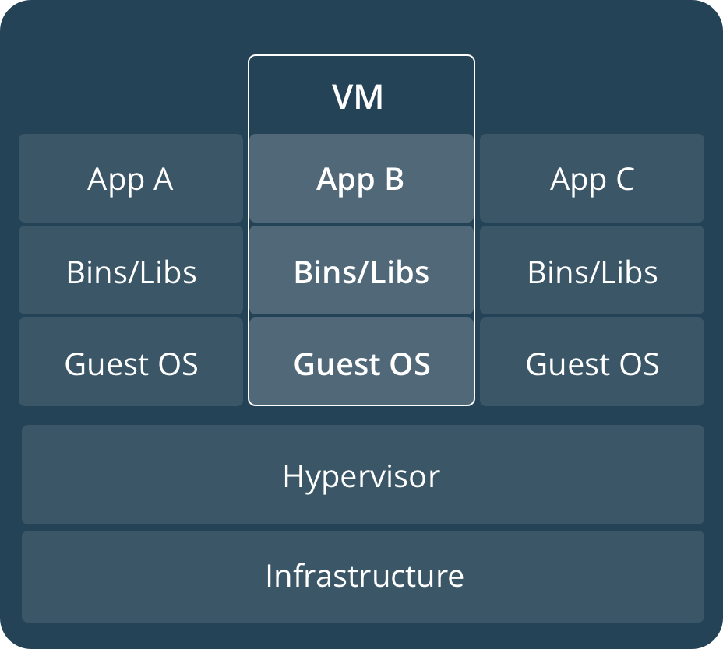
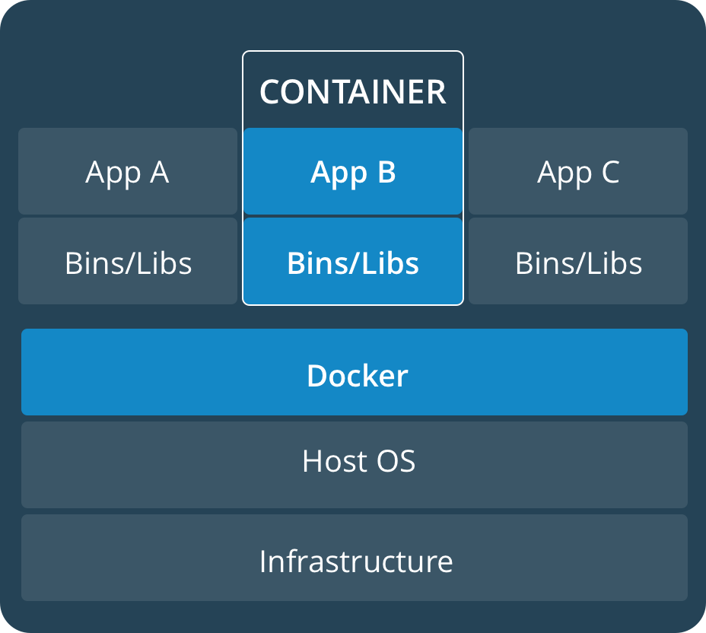
Virtual Machines vs Containers

Slide 9
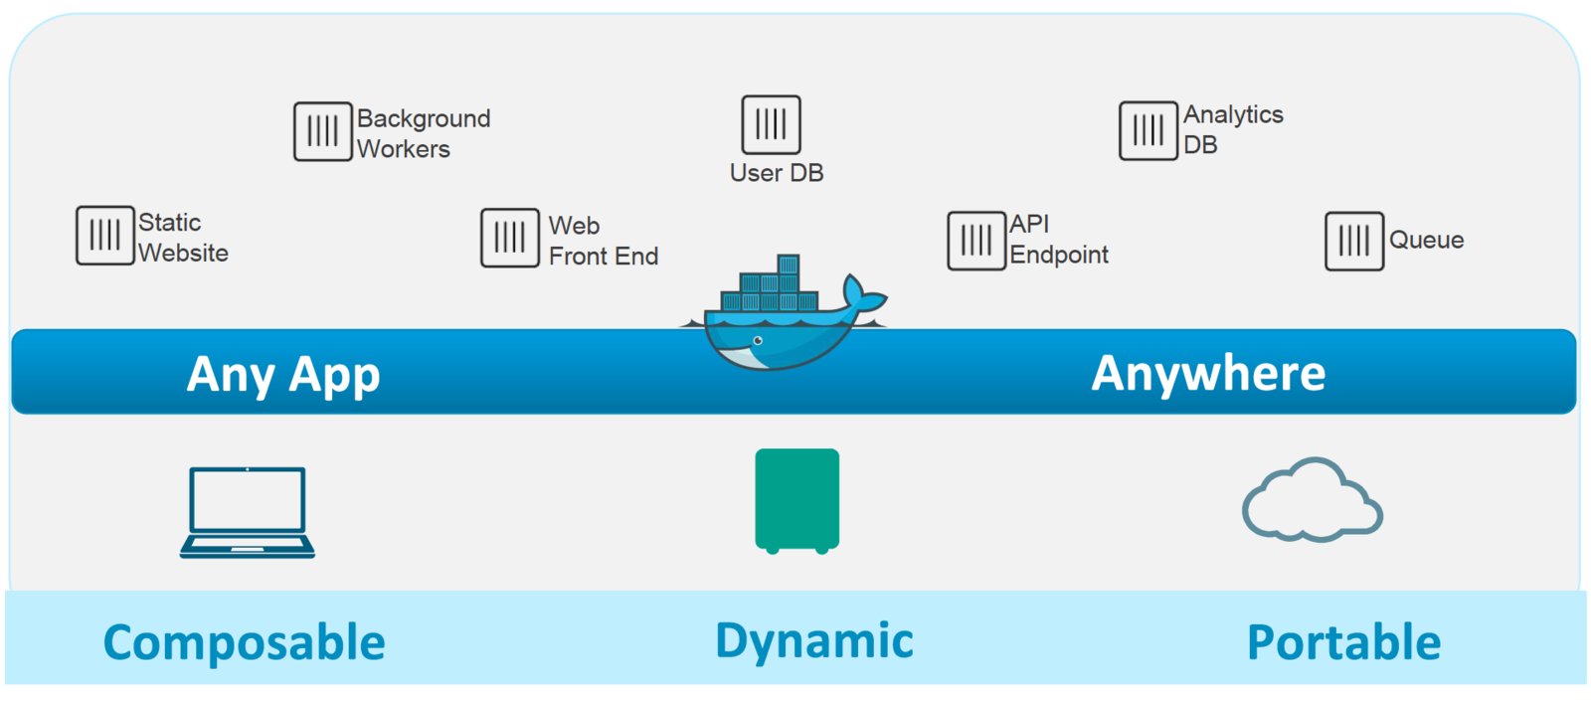
Dockerized ecosystem

Slide 10
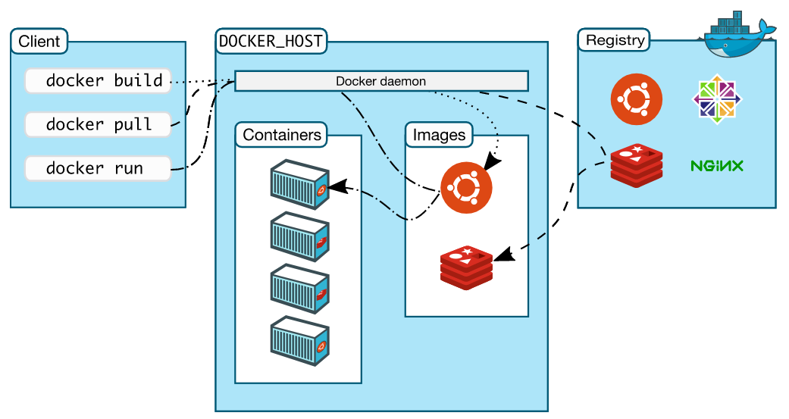
The Docker Architecture

Slide 11
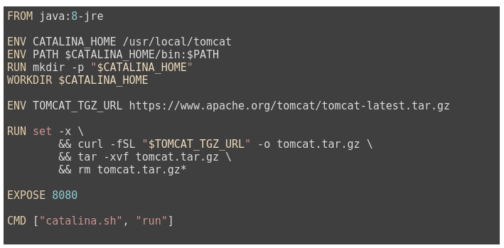
Anatomy of a Dockerfile
Image
An image is built from a Dockerfile. A file describing how the image is supposed to behave, what it extends from, ...

Slide 12
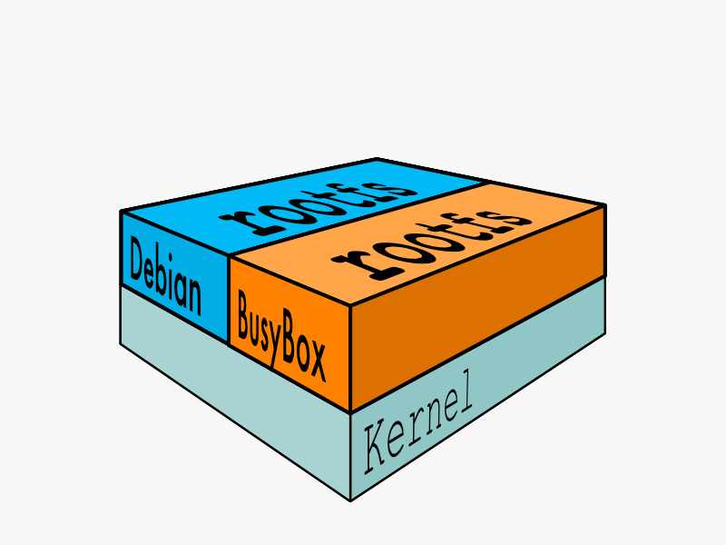
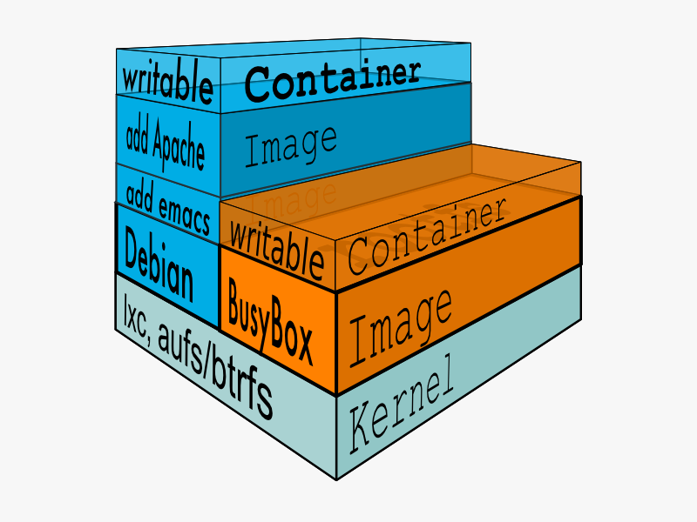
How images get built

Slide 13
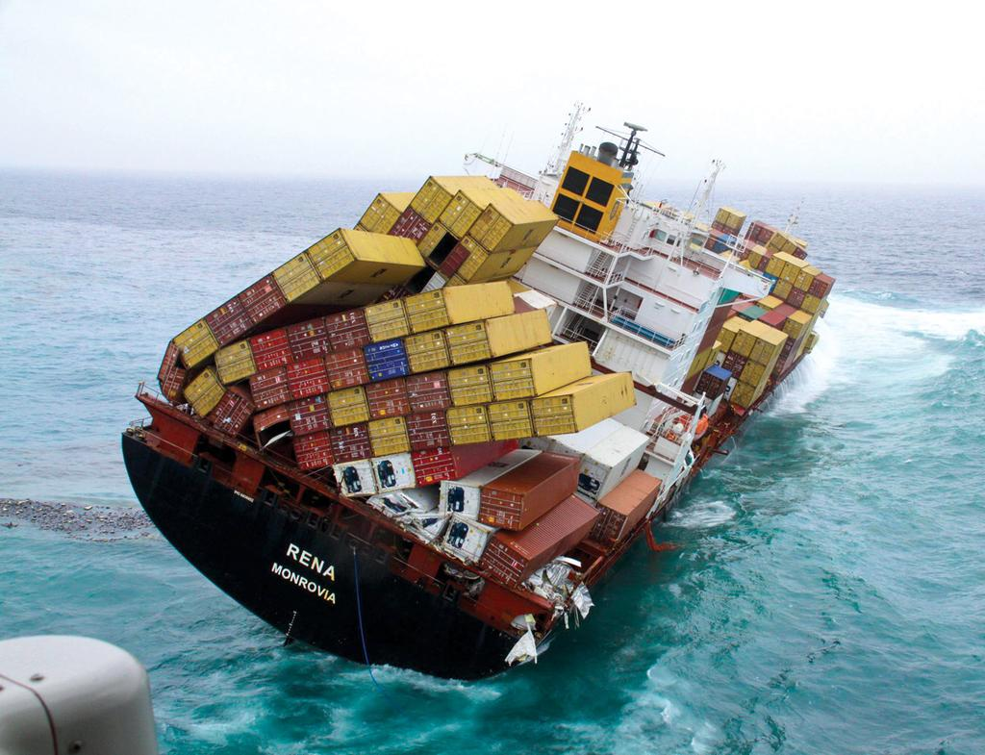
Workshop time!!

Slide 14
GRACIAS

